Slide 1
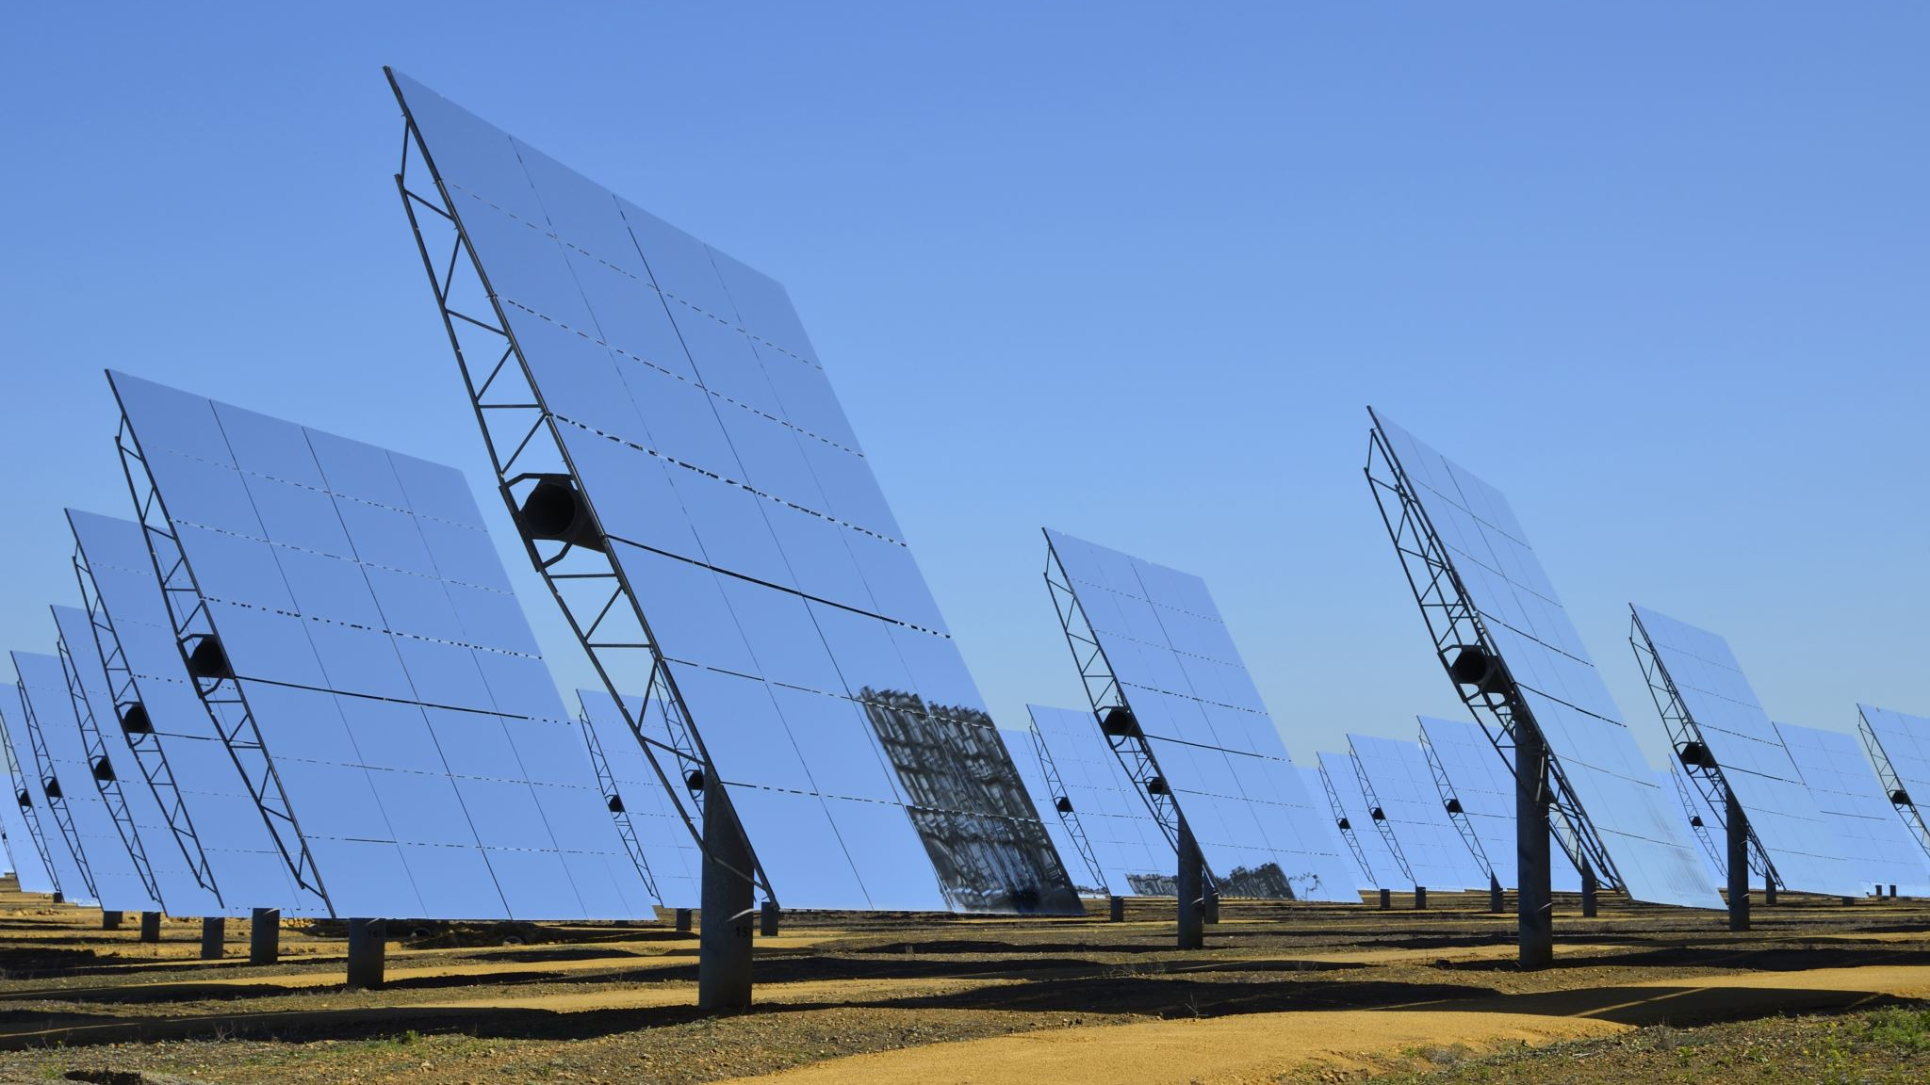
Weather station project
by Agnieszka Welian, Mikołaj Szopa, Bartosz Trynda

Slide 2

Introduction
Smart ideas are nowadays more and more popular not only in major companies but also in private homes. One of the desired solution is a monitoring of the basic parameters as temperature, humidity and air quality.
The aim of the project is to create a weather station which will allow to monitor several parameters inside and outside the home.

Slide 3
Goals
Learn
get to know Arduino platform and communication protocols
Implement
Connect physically all the sensors to the Arduino board and prepare proper implementation
Display
Display values on the LCD screen (or in Android app)

Slide 4
Used components
Arduino MKR WiFi 1010
LCD Nextion screen (2.8')
BMP280 – digital barometer
DS18B20 – digital temperature sensor
DHT11 –digital humidity and temperature sensor
CSS811 – digital air quality sensor
MQ9 – analogue combustible gas sensor
Photorestitior

Slide 5
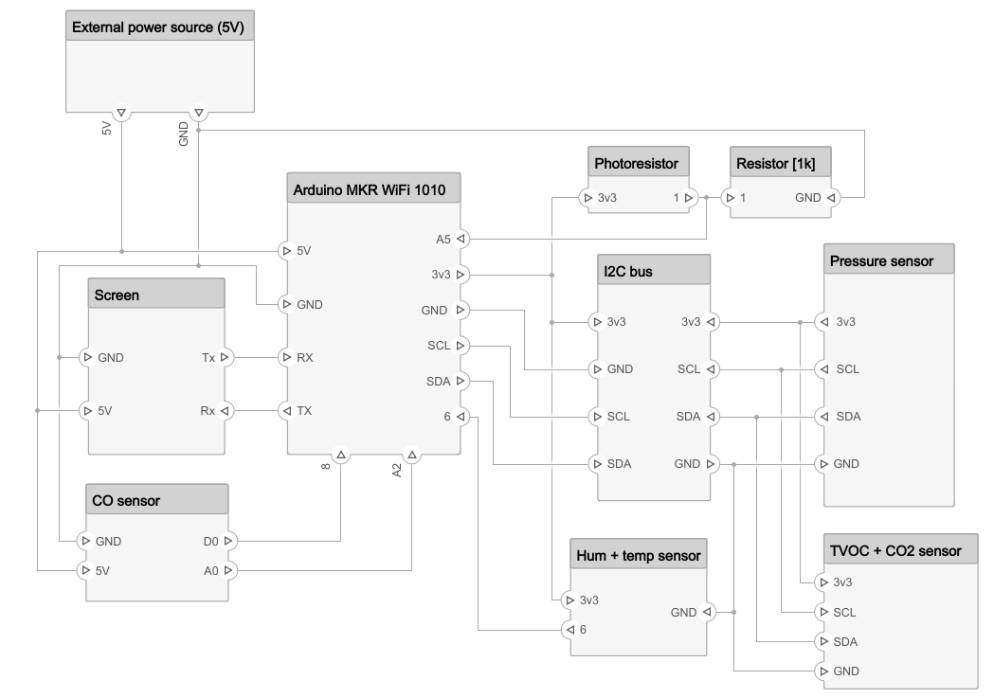
Composed elements

Slide 6


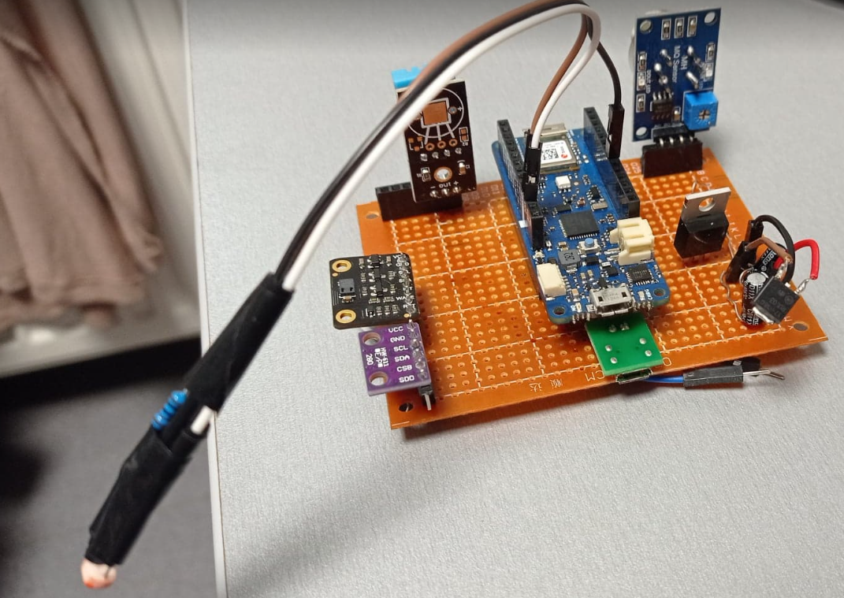
Project issues
I2C problems when using more than 1 sensor on I2C bus,
Connection with the LCD screen,
Problem with the power supply to one of the sensors,
Prototype board problems with voltage

Slide 7
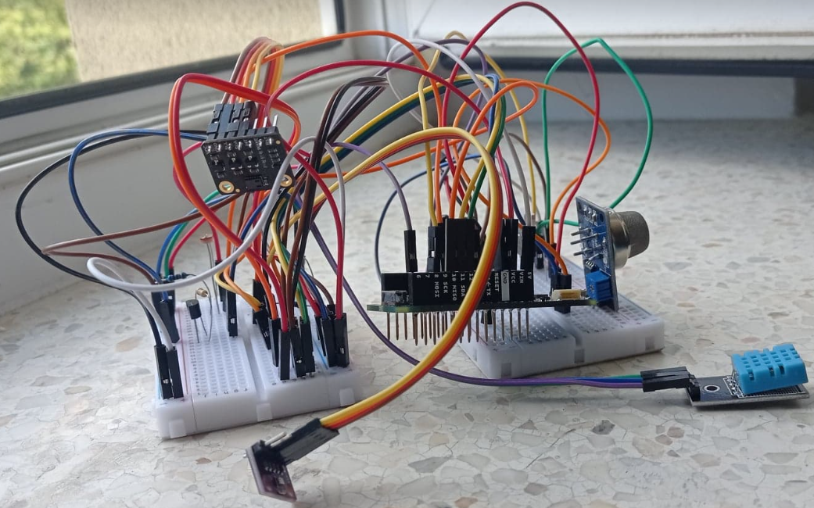
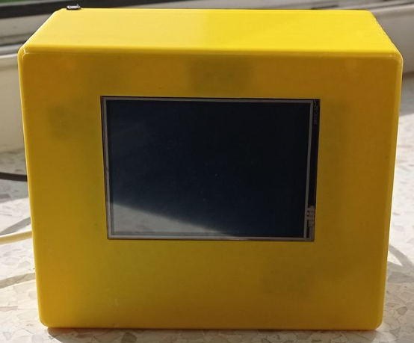
Weather station appearance
Before
After

Slide 8
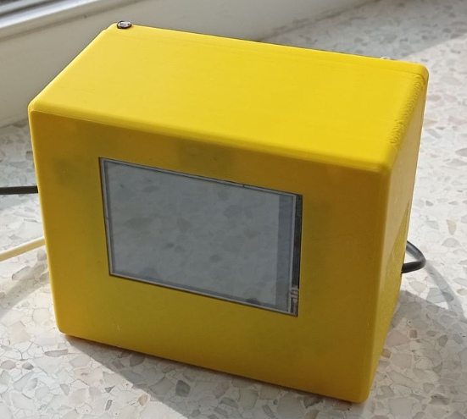
Final results

Slide 9

Thank you

